Slide 1
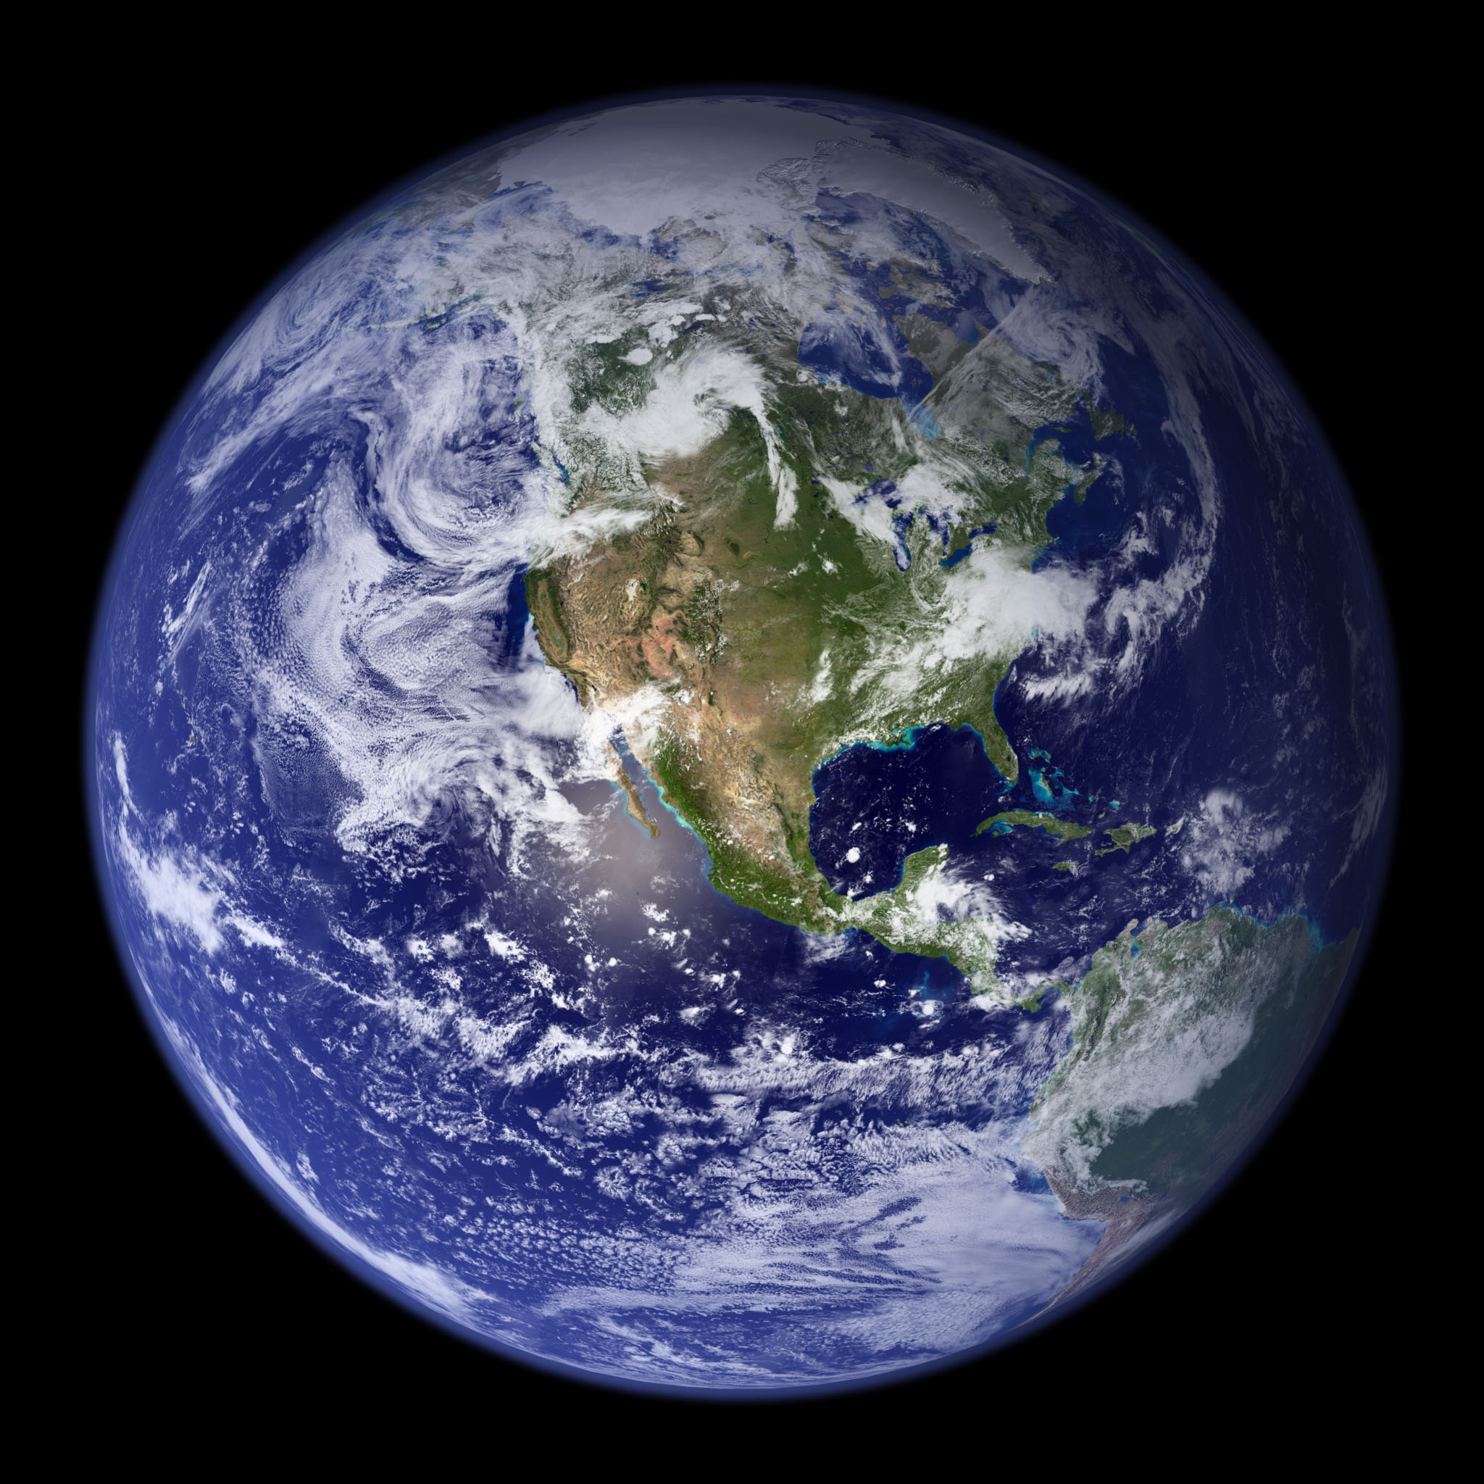

Week 4
Weather and
Weather
Forecasting
387439
Notes:
3:47 long

Slide 2
Questions from last week or videos
How weather forecasts are made
Why do good forecasts go bad?
Extratropical cyclone structure
How to use the web to see today’s weather
How to use ManUniCast to make your own forecast
Weather safety in the field
Kahoot!

Slide 3
For Week 4...
Videos:
Extratropical cyclones
How does the jet stream control the weather in the midlatitudes?
Weather around the world
Both sides now: Clouds
Required Reading:
Midlatitude Cyclones (Schultz 2011)
Mountain Safety: Student Ambassador Insights

Slide 4
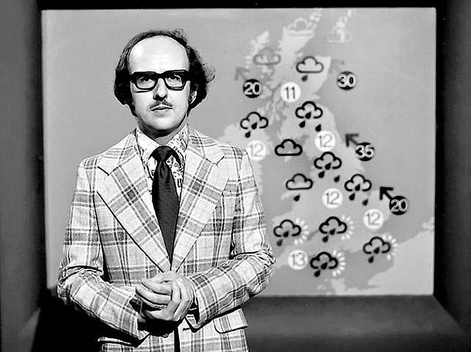
Why Do Good Weather Forecasts Go Bad?

Slide 5
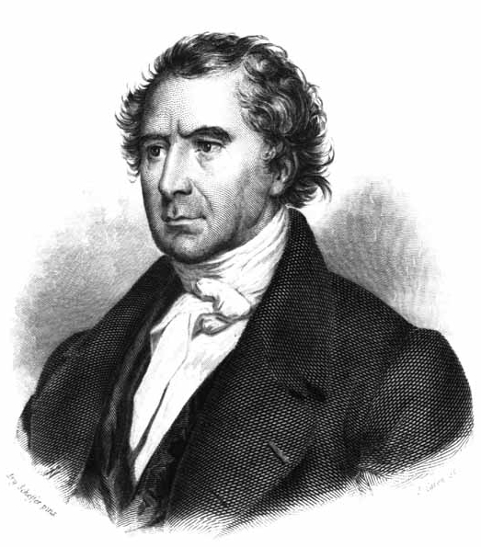
Early meteorology was not a science.
“Whatever may be the progress of sciences, NEVER will observers
who are trust-worthy, and careful of their reputation, venture to foretell the state of the weather.”
François Arago (1846)
Notes:
Before 1920, weather forecasting was done by a set of empirical rules of thumb, passed down from forecaster to forecaster. Weather maps containing the current state of the atmosphere from all over the region were not available, so understanding the current state, let alone any future states of the atmosphere was not possible. The state of weather forecasting at this time was stated quite bluntly by Francois Arago, who was the Director of the Paris Observatory and the Permanent Secretary of the French Academy of Sciences. In 1846, he said, “Whatever may be the progress of sciences, NEVER will observers who are trust-worthy, and careful of their reputation, venture to foretell the state of the weather.”

Slide 6
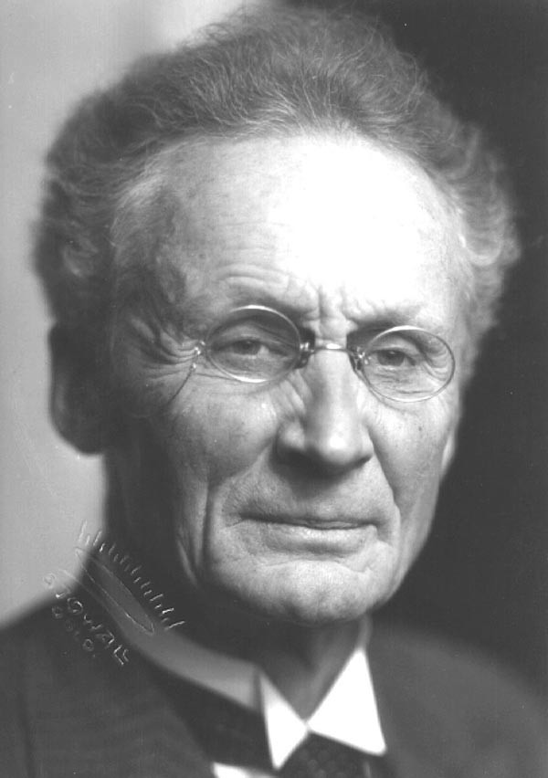
Modern meteorology began in Norway.
Vilhelm Bjerknes (1904)

Slide 7
Modern meteorology began in Norway.
Subsequent atmospheric states develop from the preceding ones according to physical law.
Vilhelm Bjerknes (1904)

Slide 8
How to make a weather forecast:
  1. A sufficiently accurate knowledge of the state of the atmosphere at the initial time
  2. A sufficiently accurate knowledge of the laws according to which one state of the atmosphere develops from another.
Vilhelm Bjerknes (1904)

Slide 9
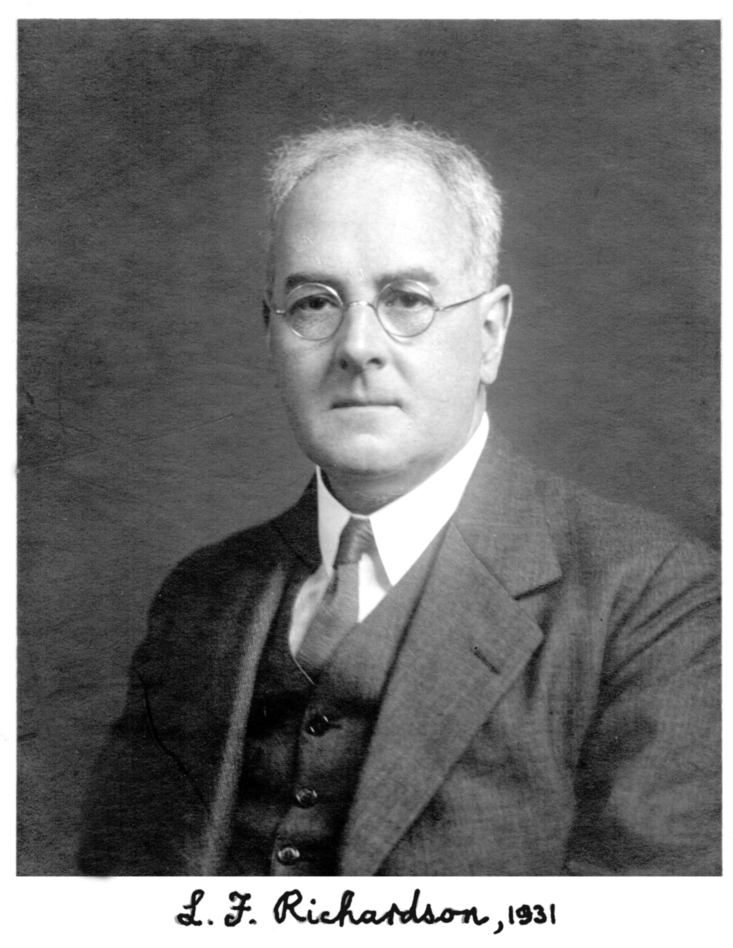
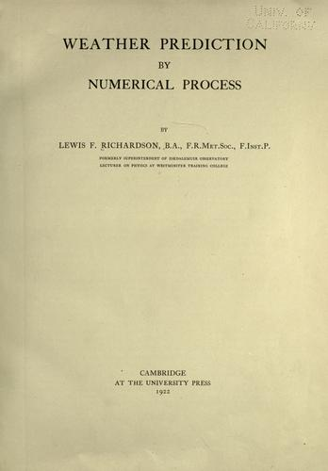
Lewis Fry Richardson devised such an approach in 1922.

Slide 10
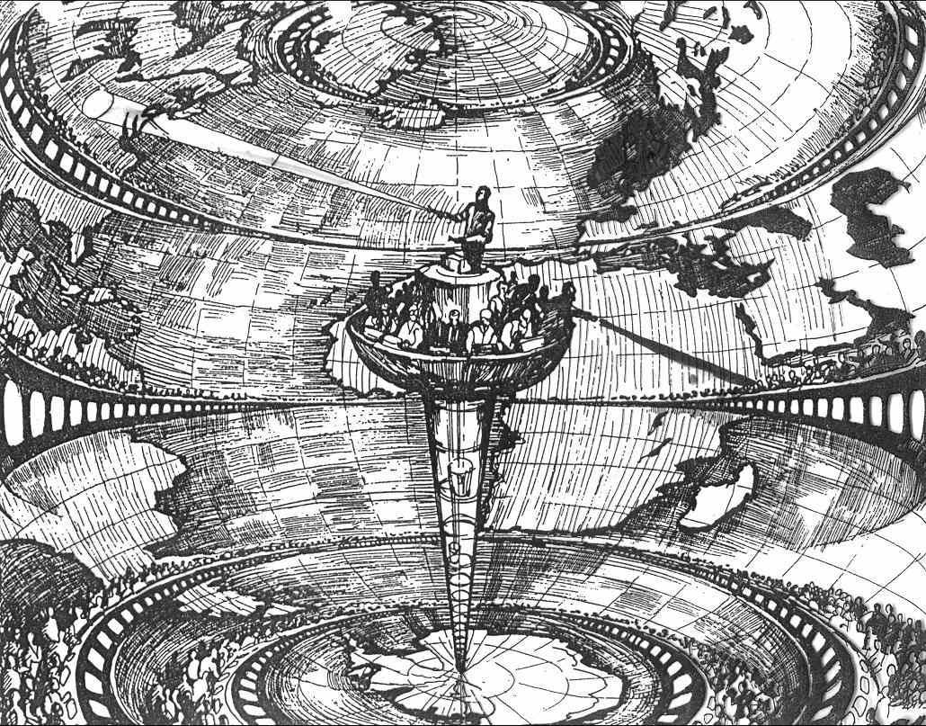
Richardson’s “Dream”: The Forecast Factory
220 km
on a side
UK
conductor
64,000
human
computers

Slide 11
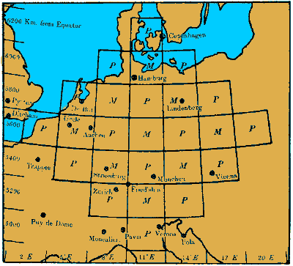
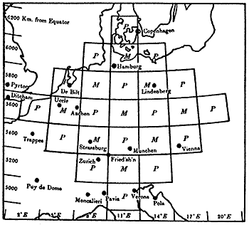
Richardson’s attempt was comparatively modest.

Slide 12
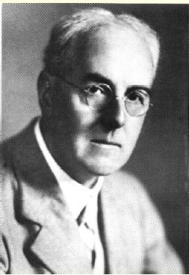
Richardson failed spectacularly.
Months of calculations
Pressure changes were 10–100 times too large!
But,
he devised many of the modern principles of modern numerical weather forecasts.
He was 30 years ahead of his time.

Slide 13
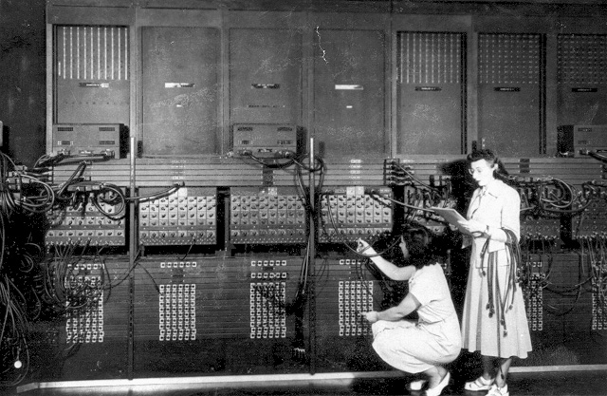
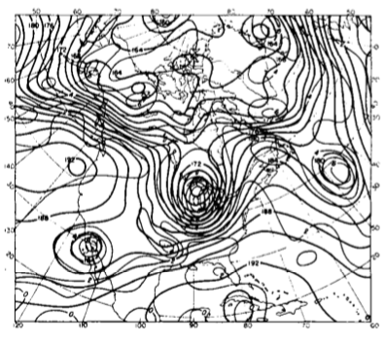
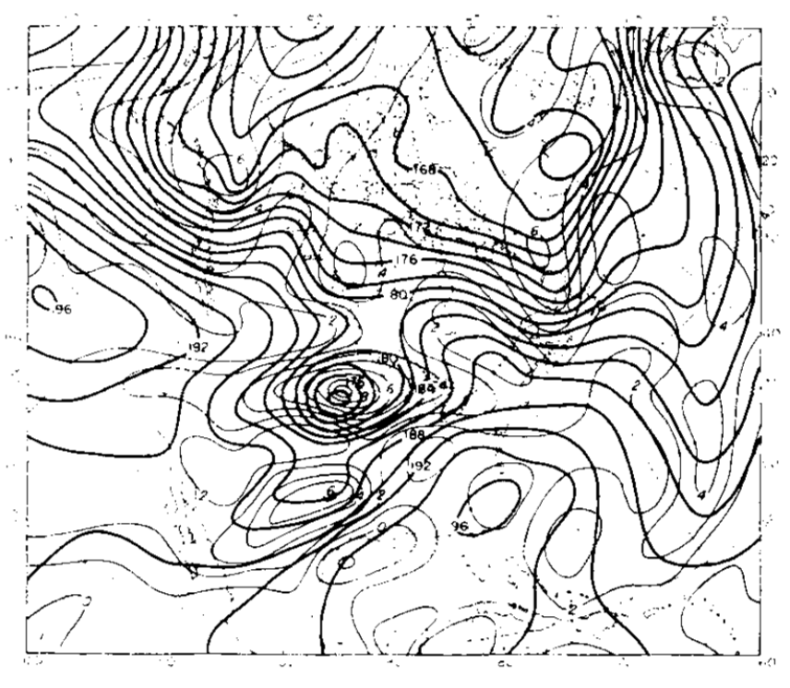
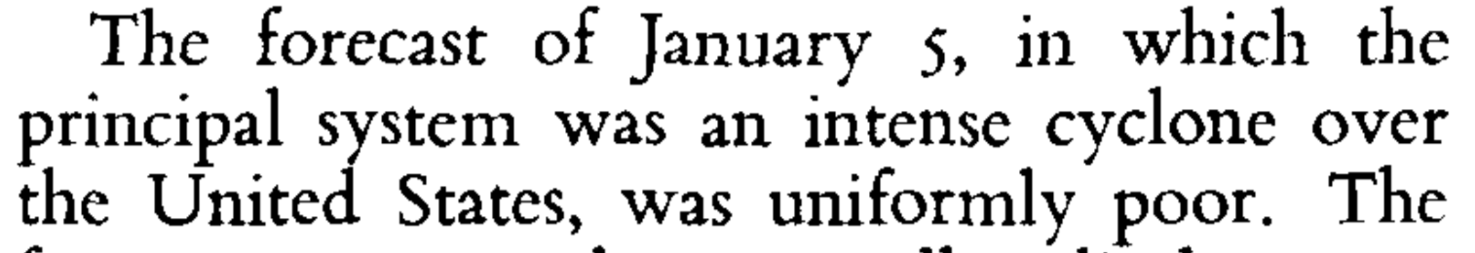
In 1949, Charney, Fjørtoft, and von Neumann made the first computer-generated forecast of flow in the middle atmosphere.
ENIAC
observed
0300 UTC 6 January 1949
24-h forecast
0300 UTC 6 January 1949

Slide 14
fast forward & present…>

Slide 15

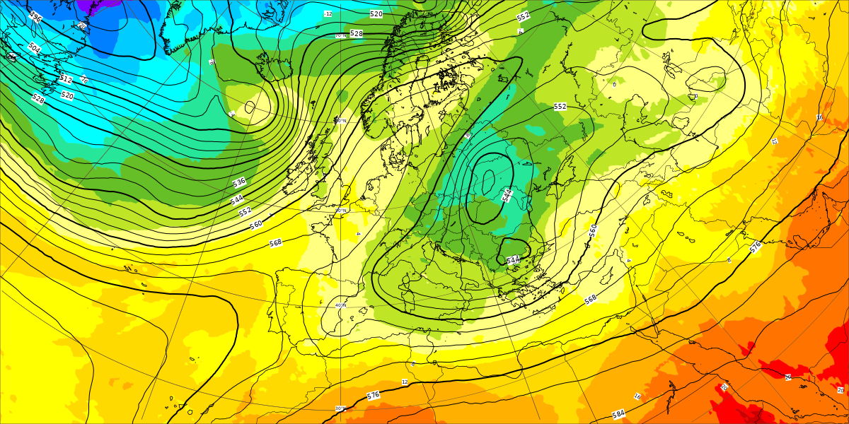
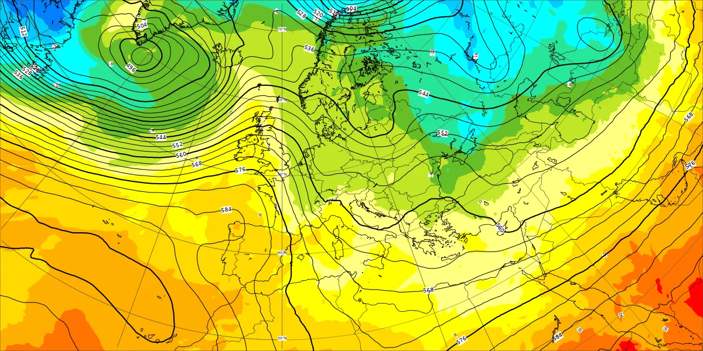
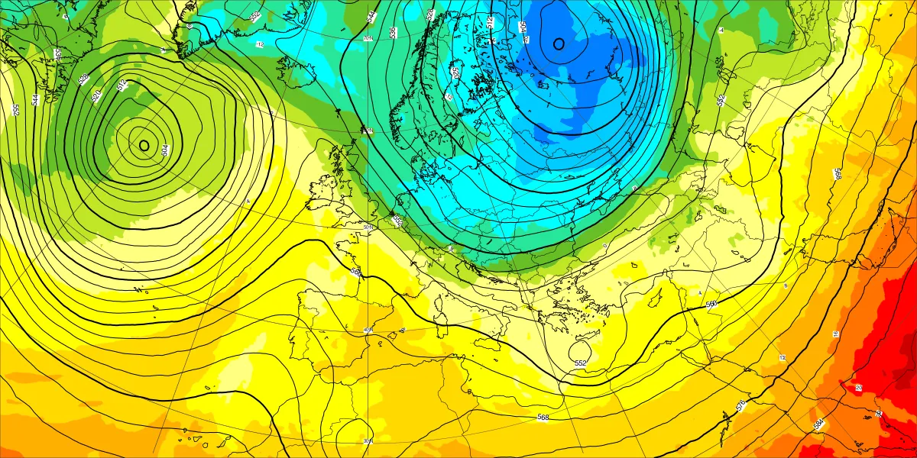
European Centre for Medium-Range Weather Forecasts (Reading, UK)
https://charts.ecmwf.int/
Jet stream and 1.5-km temperature
Actual conditions for midnight 0000 UTC Monday 17 February
Notes:
15
https://charts.ecmwf.int/products/medium-z500-t850

Slide 16
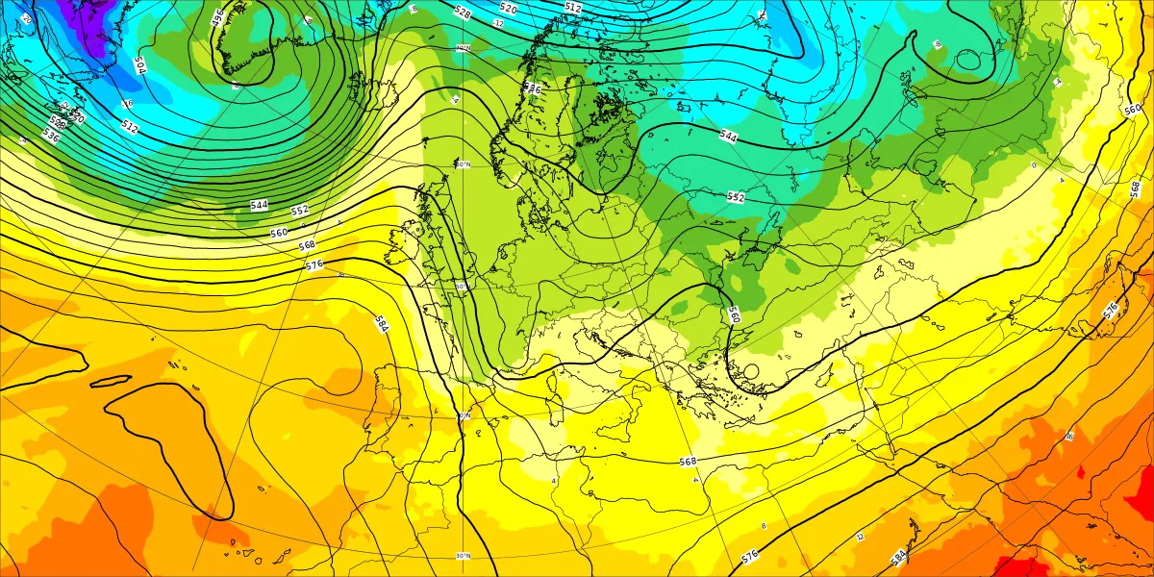
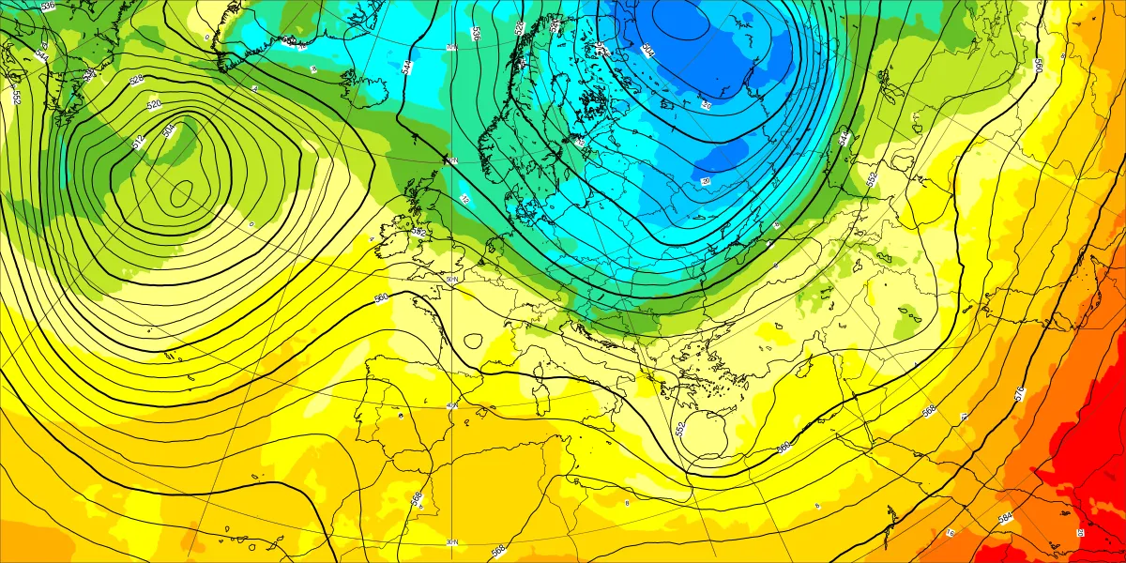
European Centre for Medium-Range Weather Forecasts (Reading, UK)
https://charts.ecmwf.int/
Jet stream and 1.5-km temperature
5-day forecast made at 0000 UTC 12 Feb for 0000 UTC 17 Feb
Notes:
16

Slide 17
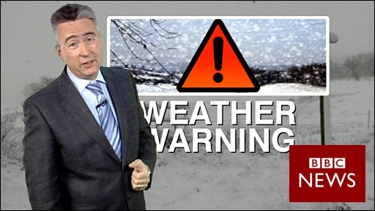
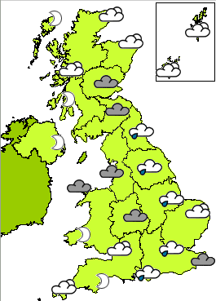
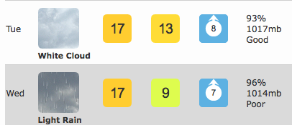
How to make a modern weather forecast

Slide 18
“1. A sufficiently accurate knowledge of the state of the atmosphere at the initial time.”
Observations are collected globally to determine the current state of the atmosphere.

Slide 19
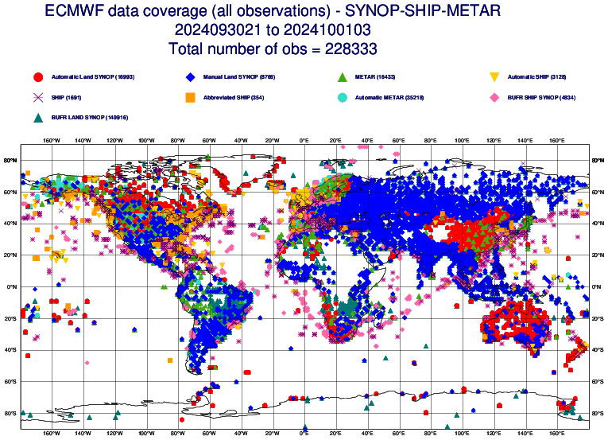
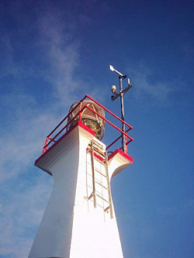
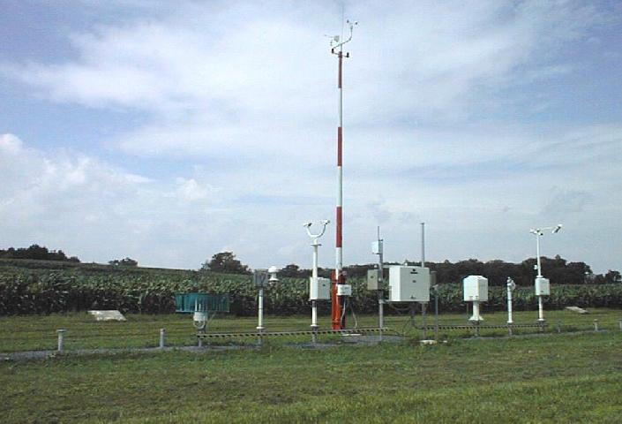
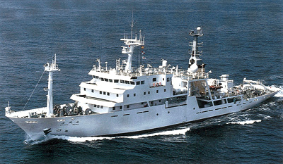
Surface Observations:
airports and ships
228,333
Notes:
https://charts.ecmwf.int/catalogue/packages/monitoring/products/dcover

Slide 20
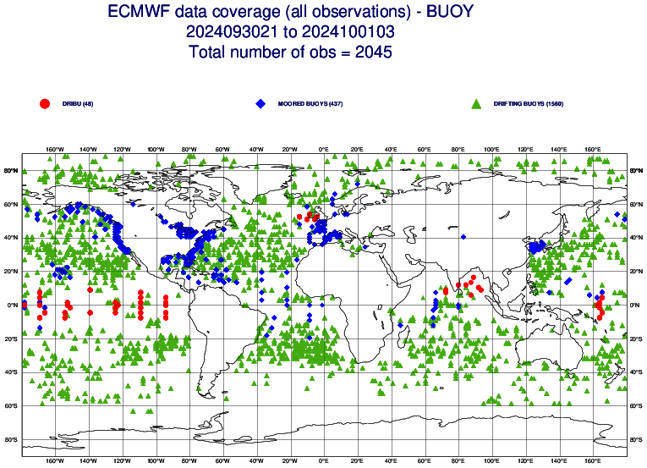
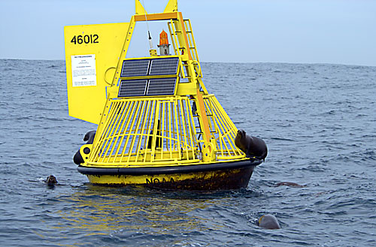
Surface Observations:
buoys
2045
Notes:
https://charts.ecmwf.int/catalogue/packages/monitoring/products/dcover

Slide 21
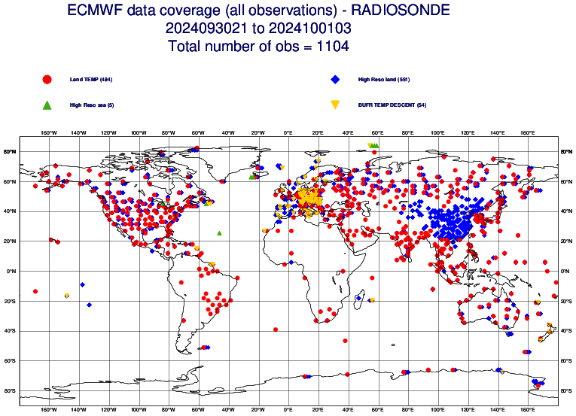
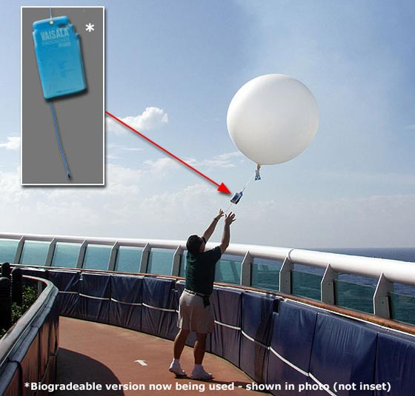
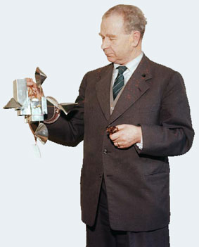
Upper-Air Observations:
radiosondes
1104
Professor Vilho Väisälä
Notes:
https://charts.ecmwf.int/catalogue/packages/monitoring/products/dcover

Slide 22
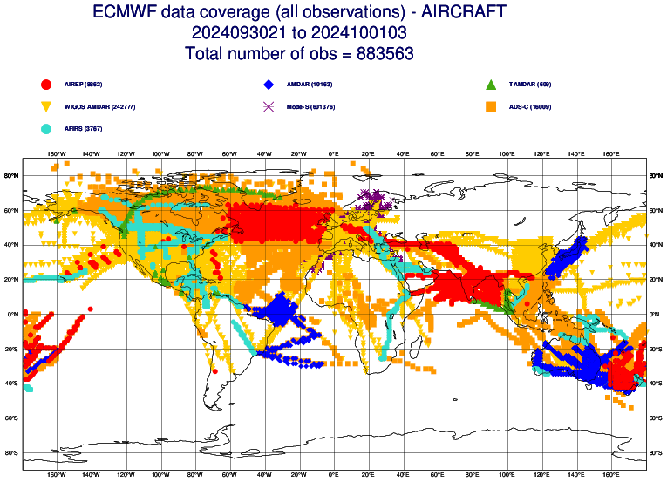
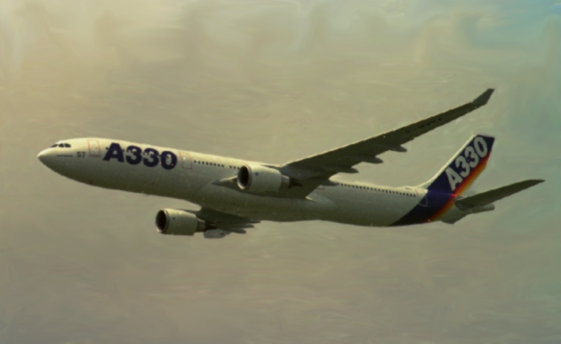
Aircraft Observations:
883,563
Notes:
https://charts.ecmwf.int/catalogue/packages/monitoring/products/dcover

Slide 23
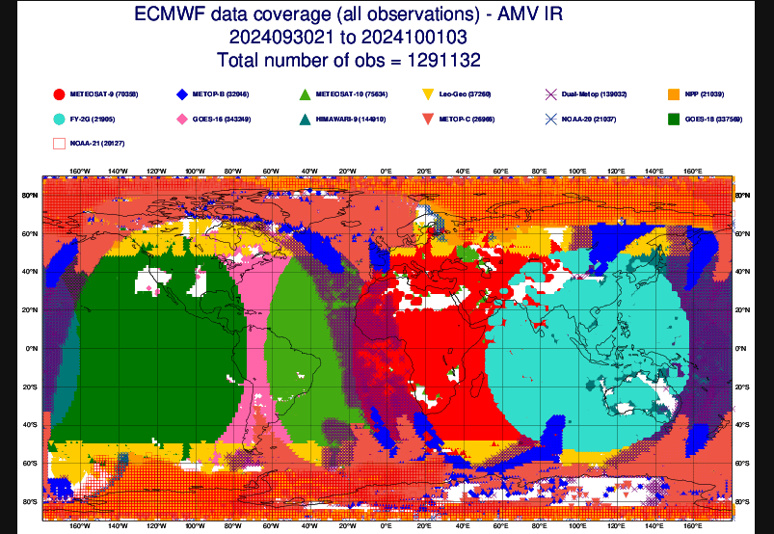
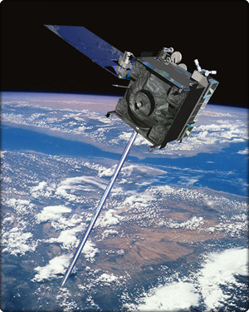
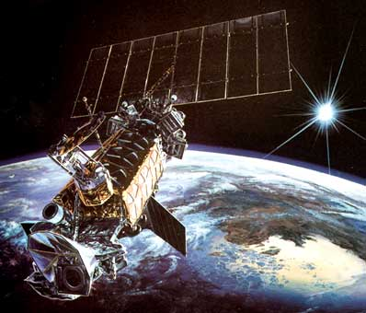
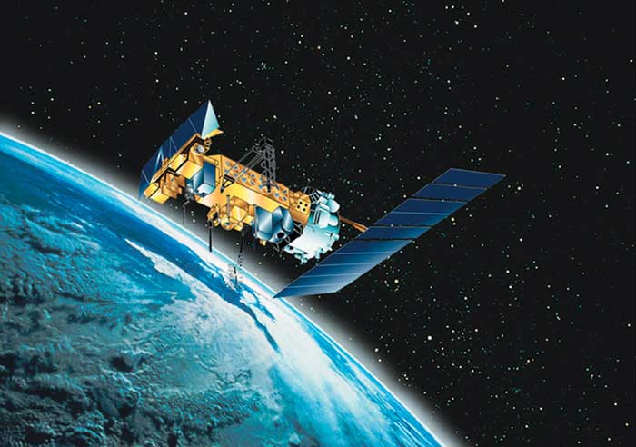
Satellite Observations:
>8,800,000
Notes:
https://charts.ecmwf.int/catalogue/packages/monitoring/products/dcover

Slide 24
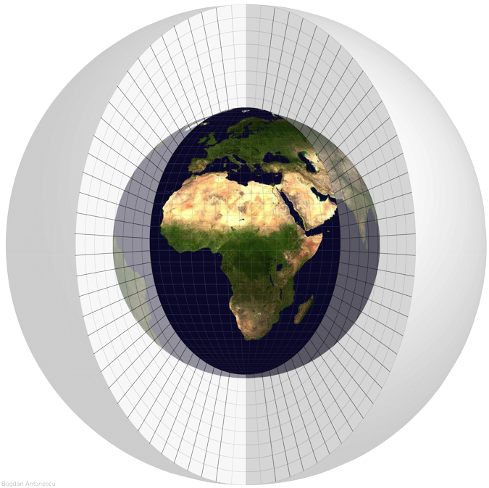
Data is interpolated onto a global grid.
Bogdan Antonescu

Slide 25
“2. A sufficiently accurate knowledge of the laws according to which one state of the atmosphere develops from another.”
The laws of physics are programmed to create a computer model of the atmosphere.

Slide 26
Laws of the Atmosphere
Ideal Gas Law: relationship between pressure, temperature, and volume of the air
Mass (water) is conserved.
Mass (air) is conserved.
How temperature changes
How wind changes

Slide 27

Laws of the Atmosphere
Mass (water) is conserved.
Mass (air) is conserved.
How temperature changes
How wind changes

Slide 28
Laws of the Atmosphere
density
constant
pressure
temperature
Mass (water) is conserved.
Mass (air) is conserved.
How temperature changes
How wind changes

Slide 29
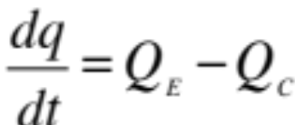
Laws of the Atmosphere
Mass (air) is conserved.
How temperature changes
How wind changes

Slide 30
Laws of the Atmosphere
evaporation rate
rate of change in time of
water vapor mixing ratio
condensation rate
Mass (air) is conserved.
How temperature changes
How wind changes

Slide 31
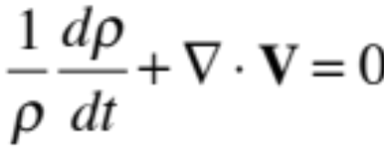
Laws of the Atmosphere
How temperature changes
How wind changes

Slide 32
Laws of the Atmosphere
rate of change in time of
density (usually small)
divergence of the 3D velocity field
How temperature changes
How wind changes

Slide 33
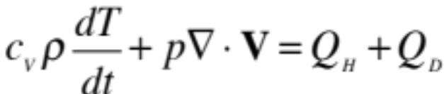
Laws of the Atmosphere
How wind changes

Slide 34
Laws of the Atmosphere
rate of change in time of
temperature
sensible heating rate
divergence of the 3D velocity field
latent heating rate
How wind changes
Notes:
c_v is the specific heat of air at constant volume

Slide 35
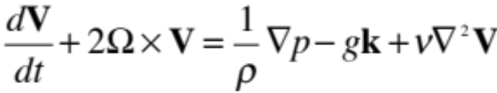
Laws of the Atmosphere

Slide 36
Laws of the Atmosphere
rate of change in time of
3D velocity
dissipation (viscosity)
gravity
Coriolis force
3D pressure gradient

Slide 37
Laws of the Atmosphere
Ideal Gas Law
Mass (water) is
conserved.
Mass (air) is
conserved.
How temperature
changes
How wind changes

Slide 38
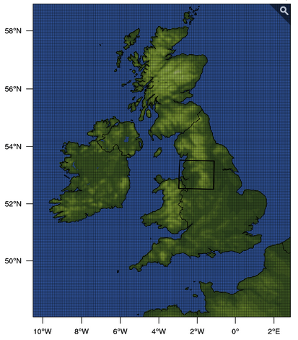
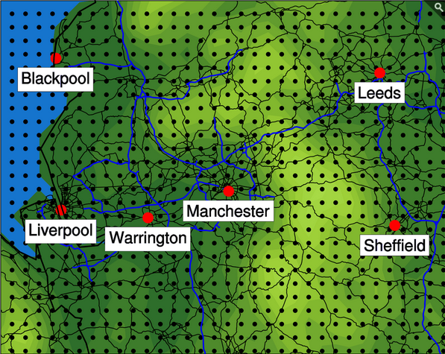
These laws are written in a form that computers can understand.
differential equations
⎝ finite differences

Slide 39

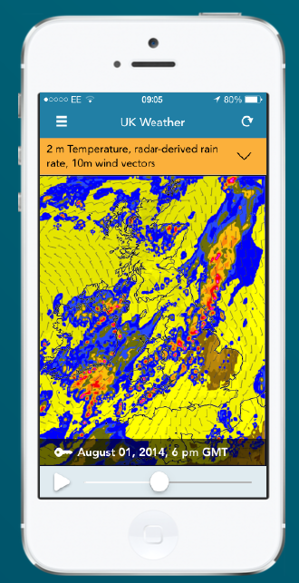
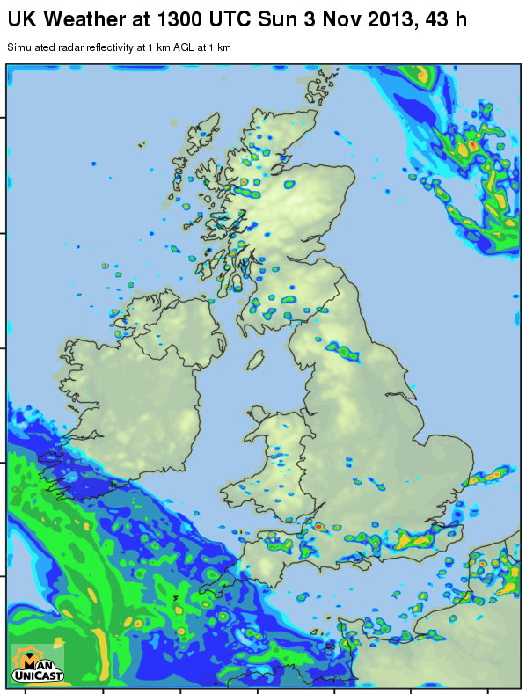
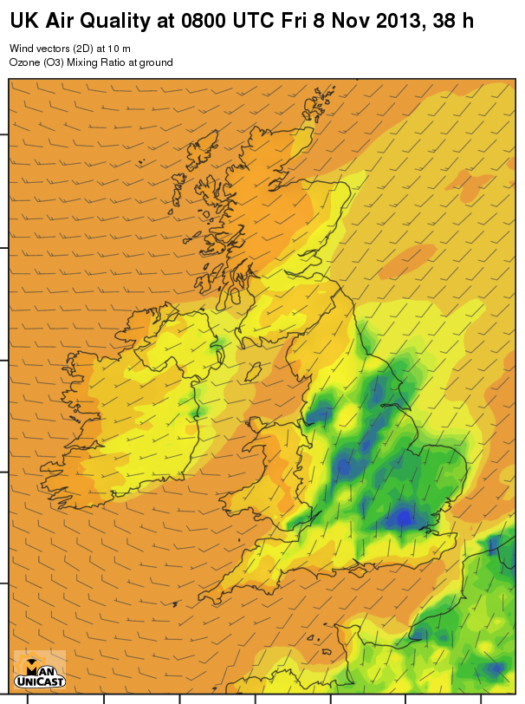
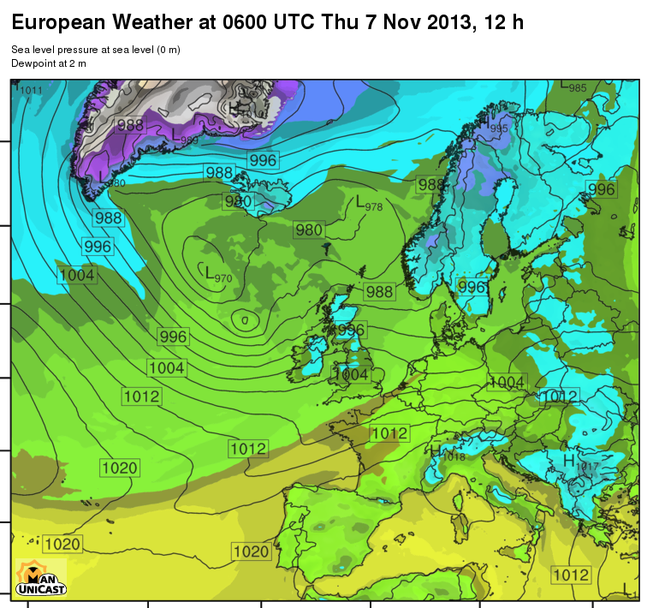


ManUniCast.com
Free weather and air-quality forecasts from the
Dept of Earth and Environmental Sciences

Slide 40
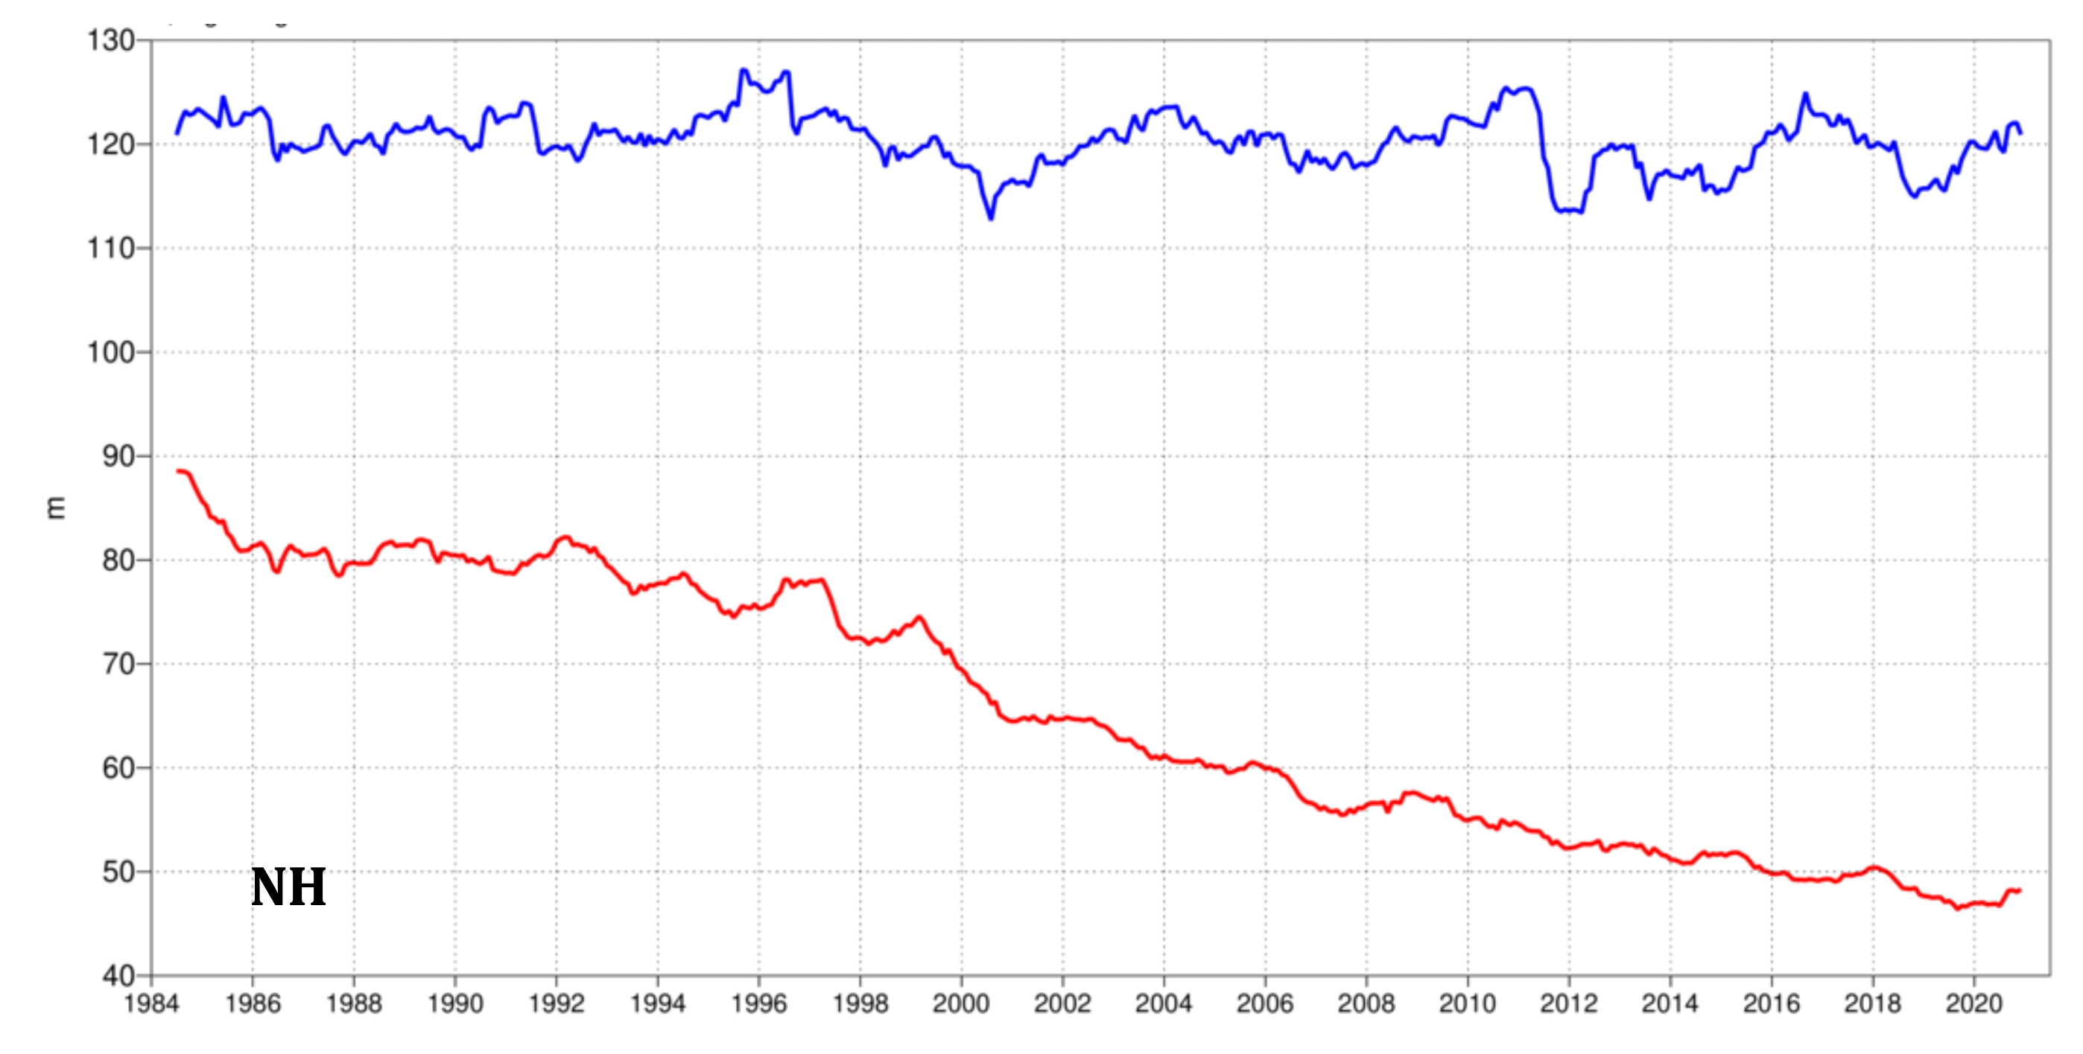

6-day persistence error
6-day forecast error
Northern Hemisphere
Root-mean-square error of ECMWF forecasts of 500-hPa geopotential height (m) at day 6 (red), verified against
analysis. For comparison, a reference forecast made by persisting the analysis over 6 days is shown (blue).
Plotted values are 12-month moving averages; the last point on the curves is for the 12-month period
August 2020–July 2021.
Notes:
https://www.ecmwf.int/en/elibrary/81235-evaluation-ecmwf-forecasts-including-2021-upgrade

Slide 41
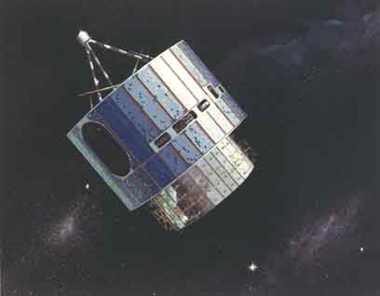


OBSERVATIONS
Notes:
First, observations of the atmosphere are collected from all kinds of instruments (radars, satellites, weather balloons, surface instrumentation) from all over the world,
providing the initial state for the computer models.

Slide 42

OBSERVATIONS
COMPUTER FORECASTS
Notes:
Coupled with the laws of physics and approximations of how we think the atmosphere works, these observations are fed into computers to produce numerical forecasts.

Slide 43

OBSERVATIONS
COMPUTER FORECASTS
HUMAN
FORECASTER
Notes:
These numerical forecasts then are studied by a human forecaster. Their quality is evaluated, and the model forecast is revised, enhanced, and interpreted by the human.

Slide 44

OBSERVATIONS
COMPUTER FORECASTS
USERS
HUMAN
FORECASTER
Notes:
These forecasts are written in a form for the end user, whether private sector companies, aviation, agriculture, or the public. This end user is you!
What I want to do is to go through these four steps in more detail, and show you some of what is happening at the university, FMI, and Vaisala to bring you the weather forecasts and make them better.

Slide 45
So, meteorologists should make
perfect weather forecasts, right?

Slide 46
Why good forecasts go bad…
So, meteorologists should make
perfect weather forecasts, right?

Slide 47
Reason #1: Imperfect Knowledge About Current State of Atmosphere

Slide 48
Reason #1: Imperfect Knowledge About Current State of Atmosphere
Data voids
Interesting weather in between observing locations
Instrument sensitivity and errors
No observations of important quantities

Slide 49


Slide 50

www.dropletmeasurement.com
Notes:
50

Slide 51
We do not have the observations
to know what’s going on inside
the cloud within each box!

Slide 52
Reason #2: Imperfect Computer Model
Need faster, more powerful computers for more grid points
Notes:
52

Slide 53
Reason #2: Imperfect Computer Model
Need faster, more powerful computers for more grid points
Need better understanding of physical processes

Slide 54

Many processes in models are parameterized.
Simplifies physical processes that we don’t fully understand or don’t have measurements of
Calculates processes occurring on scales smaller than grid boxes
Notes:
54

Slide 55
Reason #3: Chaos
“Butterfly effect”
Sensitive dependence to initial conditions
Notes:
55

Slide 56



Prof. Ed Lorenz
time ➔
(Verlaan and Heemink 2001)
Notes:
56

Slide 57
Prof. Ed Lorenz
time ➔
(Verlaan and Heemink 2001)
Notes:
57

Slide 58
Prof. Ed Lorenz
time ➔
bifurcation
(Verlaan and Heemink 2001)
Notes:
58

Slide 59
Prof. Ed Lorenz
5.123 on printed output
5.123456 internal memory of computer
time ➔
bifurcation
(Verlaan and Heemink 2001)
Notes:
59

Slide 60
Prof. Ed Lorenz
Small differences in initial conditions
will lead to large differences later.
time ➔
bifurcation
(Verlaan and Heemink 2001)
Notes:
60

Slide 61
Prof. Ed Lorenz
Even with a perfect model starting
with perfect initial conditions…
Notes:
61

Slide 62
Prof. Ed Lorenz
Even with a perfect model starting
with perfect initial conditions…
weather forecasting is
limited to two weeks.
Notes:
62

Slide 63

Given all these limitations, we have no right to do so well in forecasting the weather!
Dave sez:
What other discipline forecasts the future with as much success as meteorology?
Notes:
63

Slide 64

ManUniCast.com
A Community Weather and Air-Quality Forecasting Teaching Portal

Slide 65



Slide 66

Educational web site developed within the
School of Earth, Atmospheric and Environmental Sciences
Notes:
Been running on and off since June 10.

Slide 67

European Weather

Slide 68

UK Weather

Slide 69

UK Air Quality
22-h forecasted SO₂ mixing ratio at the ground
valid at
1600 GMT today

Slide 70

Notes:
350 micrograms per meter cubes is 122 ppb., 125 micrograms per meter cubed is 44 ppb.

Slide 71

Today’s Forecast:
Meteogram Manchester

Slide 72

Locations of
Skew-T–logp
diagrams
and meteograms

Slide 73
ManUniCast.com
Educational web site developed within the
School of Earth, Atmospheric and Environmental Sciences

Slide 74
Themes for Today
In principle, weather forecasting is easy.
  Initial state of atmosphere (observations)
  Laws of atmosphere (physics)

Slide 75
Themes for Today
In principle, weather forecasting is easy.
  Initial state of atmosphere (observations)
  Laws of atmosphere (physics)
In practice, it is more difficult.
  Errors in initial state
  Approximations
  Chaos

Slide 76
Themes for Today
In principle, weather forecasting is easy.
  Initial state of atmosphere (observations)
  Laws of atmosphere (physics)
In practice, it is more difficult.
  Errors in initial state
  Approximations
  Chaos
Given the extent of the unknown initial state and the approximations used to solve the equations, that we succeed so well in weather forecasting is an amazing human accomplishment.
manunicast.com

Slide 77

Root-mean-square surface pressure error (mb) over the Northeast Atlantic Ocean
3 days
5 days
2 days
4 days
1 day
© Crown copyright
Met Office
Notes:
In many ways this graph summarises much of what the development of computers has enabled numerical weather prediction to achieve. The improved performance has been achieved through the implementation of research in the areas of finer resolution, larger domains, longer forecasts, better use of observations, better representation of atmospheric processes, and so on… Increasing computer speed and memory has enabled that research to be implemented.
In 1954, it was written in the anniversary issue of Met Mag that there had been little improvement in the manually produced 24 hour forecast over the previous 10 years, and that there was little skill at longer ranges. We may take it that, for this measure, the 1967 NWP score was similar for T+24. This level of skill was extended to 2 days by NWP in 1985 and to 3 days in 1996.

Slide 78
Root-mean-square surface pressure error (mb) over the Northeast Atlantic Ocean
3 days
5 days
2 days
4 days
9 years
1 day
© Crown copyright
Met Office
Notes:
In many ways this graph summarises much of what the development of computers has enabled numerical weather prediction to achieve. The improved performance has been achieved through the implementation of research in the areas of finer resolution, larger domains, longer forecasts, better use of observations, better representation of atmospheric processes, and so on… Increasing computer speed and memory has enabled that research to be implemented.
In 1954, it was written in the anniversary issue of Met Mag that there had been little improvement in the manually produced 24 hour forecast over the previous 10 years, and that there was little skill at longer ranges. We may take it that, for this measure, the 1967 NWP score was similar for T+24. This level of skill was extended to 2 days by NWP in 1985 and to 3 days in 1996.

Slide 79
Root-mean-square surface pressure error (mb) over the Northeast Atlantic Ocean
3 days
5 days
2 days
4 days
9 years
1 day
10 years
10 years
13 years
© Crown copyright
Met Office
Notes:
In many ways this graph summarises much of what the development of computers has enabled numerical weather prediction to achieve. The improved performance has been achieved through the implementation of research in the areas of finer resolution, larger domains, longer forecasts, better use of observations, better representation of atmospheric processes, and so on… Increasing computer speed and memory has enabled that research to be implemented.
In 1954, it was written in the anniversary issue of Met Mag that there had been little improvement in the manually produced 24 hour forecast over the previous 10 years, and that there was little skill at longer ranges. We may take it that, for this measure, the 1967 NWP score was similar for T+24. This level of skill was extended to 2 days by NWP in 1985 and to 3 days in 1996.

Slide 80
Root-mean-square surface pressure error (mb) over the Northeast Atlantic Ocean
3 days
5 days
2 days
4 days
1 day
1979
© Crown copyright
Met Office
Notes:
In many ways this graph summarises much of what the development of computers has enabled numerical weather prediction to achieve. The improved performance has been achieved through the implementation of research in the areas of finer resolution, larger domains, longer forecasts, better use of observations, better representation of atmospheric processes, and so on… Increasing computer speed and memory has enabled that research to be implemented.
In 1954, it was written in the anniversary issue of Met Mag that there had been little improvement in the manually produced 24 hour forecast over the previous 10 years, and that there was little skill at longer ranges. We may take it that, for this measure, the 1967 NWP score was similar for T+24. This level of skill was extended to 2 days by NWP in 1985 and to 3 days in 1996.

Slide 81
Root-mean-square surface pressure error (mb) over the Northeast Atlantic Ocean
3 days
5 days
2 days
4 days
1 day
© Crown copyright
Met Office
Notes:
In many ways this graph summarises much of what the development of computers has enabled numerical weather prediction to achieve. The improved performance has been achieved through the implementation of research in the areas of finer resolution, larger domains, longer forecasts, better use of observations, better representation of atmospheric processes, and so on… Increasing computer speed and memory has enabled that research to be implemented.
In 1954, it was written in the anniversary issue of Met Mag that there had been little improvement in the manually produced 24 hour forecast over the previous 10 years, and that there was little skill at longer ranges. We may take it that, for this measure, the 1967 NWP score was similar for T+24. This level of skill was extended to 2 days by NWP in 1985 and to 3 days in 1996.

Slide 82

Notes:
82

Slide 83
Notes:
83

Slide 84

Notes:
84

Slide 85
Notes:
85

Slide 86
Extratropical cyclone structure
cyclones = low-pressure system
anticyclones = high-pressure system

Slide 87
Extratropical cyclone structure
cyclones = low-pressure system
anticyclones = high-pressure system
When isobars (lines of constant pressure) are
closely packed, winds are strong.

Slide 88


Slide 89

Norwegian cyclone model
(Northern Hemisphere)
sea-level
pressure
and fronts
COLD
COLD
COLD
surface air
isotherms
WARM
WARM
Notes:
Fun fact: The Norwegian cyclone model was co-developed by Jacob Bjerknes, son of Vilhelm Bjerknes who told us how to make physically-based weather forecasts.

Slide 90
Norwegian cyclone model
sea-level
pressure
and fronts
COLD
COLD
COLD
surface air
isotherms
WARM
WARM
Notes:
Fun fact: The Norwegian cyclone model was co-developed by Jacob Bjerknes, son of Vilhelm Bjerknes who told us how to make physically-based weather forecasts.

Slide 91
Norwegian cyclone model
sea-level
pressure
and fronts
COLD
COLD
COLD
surface air
isotherms
WARM
WARM
Notes:
Fun fact: The Norwegian cyclone model was co-developed by Jacob Bjerknes, son of Vilhelm Bjerknes who told us how to make physically-based weather forecasts.

Slide 92
Norwegian cyclone model
sea-level
pressure
and fronts
COLD
COLD
COLD
surface air
isotherms
WARM
WARM
Notes:
Fun fact: The Norwegian cyclone model was co-developed by Jacob Bjerknes, son of Vilhelm Bjerknes who told us how to make physically-based weather forecasts.

Slide 93
Norwegian cyclone model
(Northern Hemisphere)
mirror
Norwegian cyclone model
(Southern Hemisphere)
Notes:
Fun fact: The Norwegian cyclone model was co-developed by Jacob Bjerknes, son of Vilhelm Bjerknes who told us how to make physically-based weather forecasts.

Slide 94
sea-level
pressure
and fronts
COLD
COLD
COLD
Norwegian cyclone model
(Southern Hemisphere)
surface air
isotherms
WARM
WARM
Notes:
Fun fact: The Norwegian cyclone model was co-developed by Jacob Bjerknes, son of Vilhelm Bjerknes who told us how to make physically-based weather forecasts.

Slide 95
Extratropical cyclone structure
cyclones = low-pressure system
counterclockwise circulation in Northern Hemisphere
clockwise circulation in Southern Hemisphere
anticyclones = high-pressure system
clockwise circulation in Northern Hemisphere
counterclockwise circulation in Southern Hemisphere

Slide 96

850-hPa height, temperature, wind barbs
animation of an idealized
cyclone, followed by an anticyclone
Schultz and Zhang (2007)
Notes:
Schultz, D. M., and F. Zhang, 2007: Baroclinic development within zonally-varying flows. Quart. J. Roy. Meteor. Soc., 133, 1101–1112.

Slide 97

HIGH
Monday’s weather
2
LOW
0°C
–6
HIGH
–13
–4
15
3
7
0000 UTC
17 Feb 2025
9

Slide 98
HIGH
Monday’s weather
2
LOW
0°C
–6
HIGH
–13
CALM
warm wind
–4
cold wind
15
3
7
0000 UTC
17 Feb 2025
9

Slide 99
Weather: 3–6 Feb 2025
Extratropical cyclone (low-pressure system)
followed by
extratropical anticyclone (high-pressure system)

Slide 100



0600 UTC 3 February 2025
Tip of warm front (analyzed just north of Manchester
passes. Slight wind shift from 200° (south-southwest) to
150°–180° (south-southeast to south).
Notes:
http://whitworth.cas.manchester.ac.uk/2025/02/03/
https://www.ncdc.noaa.gov/gibbs/image/MSG-3/VS/2025-02-03-06
https://www.wetter3.de/archiv_dwd_dt.html

Slide 101


1200 UTC 3 February 2025: Inside the warm sector
(between the warm and cold fronts). Temperature
remains high overnight (8°C).
Notes:
http://whitworth.cas.manchester.ac.uk/2025/02/03/
https://www.ncdc.noaa.gov/gibbs/image/MSG-3/VS/2025-02-03-12
https://www.wetter3.de/archiv_dwd_dt.html

Slide 102






1200 UTC 4 February 2025: Cold-front passage
shortly after 1300 UTC. Rapid drop in temperature,
short burst of rain, and cooler.
Notes:
http://whitworth.cas.manchester.ac.uk/2025/02/04/
https://www.ncdc.noaa.gov/gibbs/image/MSG-3/VS/2025-02-04-12
https://www.wetter3.de/archiv_dwd_dt.html

Slide 103


1200 UTC 6 February 2025: Clear skies, sunny,
warm, under high pressure. Light winds.
Notes:
http://www.sat24.com/en-gb#selectedLayer=euVisible
https://www.wetter3.de/archiv_dwd_dt.html

Slide 104


Today: 6 February 2025: Clear skies, sunny, warm, under high pressure. Light winds.
The solar radiation curve is almost a parabola, indicating no clouds.
Notes:
http://www.cas.manchester.ac.uk/restools/whitworth/data/

Slide 105

https://www.bbc.co.uk/news/uk-scotland-64662300

Slide 106


wetter3.de
L
strong
pressure
gradient →
strong winds
Manchester
warm wind
cold wind
CALM
0600 UTC
20 Feb 2024
Tuesday

Slide 107

wetter3.de
strong
pressure
gradient →
strong winds
L
–1°C
16°C
CALM
0600 UTC
18 Feb 2023
Sunday

Slide 108

wetter3.de
strong
pressure
gradient →
strong winds
L
CALM
1200 UTC
18 Feb 2023
Sunday

Slide 109

wetter3.de
strong
pressure
gradient →
strong winds
L
CALM
1800 UTC
18 Feb 2023
Sunday

Slide 110

wetter3.de
strong
pressure
gradient →
strong winds
L
CALM
0000 UTC
19 Feb 2023
Monday

Slide 111

wetter3.de
strong
pressure
gradient →
strong winds
L
CALM
0600 UTC
19 Feb 2023
Monday

Slide 112

wetter3.de
strong
pressure
gradient →
strong winds
L
CALM
1200 UTC
19 Feb 2023
Monday

Slide 113

wetter3.de
strong
pressure
gradient →
strong winds
L
CALM
1800 UTC
19 Feb 2023
Monday

Slide 114

wetter3.de
L
strong
pressure
gradient →
strong winds
CALM
0000 UTC
20 Feb 2023
Tuesday

Slide 115
wetter3.de
L
strong
pressure
gradient →
strong winds
CALM
0600 UTC
20 Feb 2023
Tuesday

Slide 116
Extratropical anticyclones

Slide 117



Front Range
Rockies
1200 UTC
13 Feb 2021 (°F)

Slide 118
How to use the web to see today’s weather

Slide 119
Observations Forecast
PAST
NOW
FUTURE
surface maps
satellite
radar
forecast model
output of all those
things

Slide 120


Slide 121
Surface maps: http://wetter3.de
Observations and Forecasts
DWD

Slide 122

Satellite imagery: sat24.com
Observations
Notes:
Satellite animations
Infrared versus visible imagery
Cloud types

Slide 123
Radar: Observation
https://www.netweather.tv/live-weather/radar/

Slide 124


Lightning: Observation
https://www.blitzortung.org

Slide 125

Forecast for Manchester
https://www.metoffice.gov.uk/weather/forecast/gcw2hzs1u#

Slide 126
Forecast for Manchester
How do they make post-code forecasts?
https://www.metoffice.gov.uk/weather/forecast/gcw2hzs1u#

Slide 127
How to use ManUniCast
to make your own forecast
manunicast.com

Slide 128

ManUniCast.com

Slide 129
Weather safety in the field

Slide 130
This lecture could
save your life.

Slide 131



Olivia Heard, third-year BSc
Geology/Geography student
https://www.mub.eps.manchester.ac.uk/sees/2021/01/21/mountain-safety-student-ambassador-insights/

Slide 132


LIGHTNING

Slide 133

On average in UK:
2 deaths per year
29 injuries per year
(Elsom and Webb 2017)
Notes:
Elsom, D.M. and Webb, J.D., 2017. Lightning deaths in the UK: a 30-year analysis of the factors contributing to people being struck and killed. Int J Meteorology, 42(401), 8–26.

Slide 134

(Elsom and Webb 2014)
Notes:
Elsom, D. M., , and Webb J. D. C. , 2014: Deaths and injuries from lightning in the UK, 1988–2012. Weather, 69, 221–226, doi:10.1002/wea.2254.

Slide 135

Cumulus Towers
Ronald L. Holle©1990

Slide 136
Necessary Conditions for Lightning Formation
Updraft in a cumulus cloud
Below freezing at cloud top
Mixed-phase cloud:
Graupel–soft irregular hail particles
Ice crystals
Supercooled liquid water

Slide 137


When Lightning is Imminent
• hair stands on end
• sparks, electrical discharges
• St. Elmo’s fire
• hear static discharges
8/20/75: Sequoia National Park at Moro Rock: One person killed and 8 injured, the most seriously, the photographer. All were from an extended family. Hail was falling as they were at the top, 300 feet higher and 1/3 mile away from the parking lot.

Slide 138
The 30–30 Rule
      Most people who die from lightning are struck early in the storm or near the end.
      If the time between the lightning flash and the bang is 30 seconds, take shelter.
      Wait until 30 minutes after the last stroke before continuing outdoor activities.

Slide 139
Lightning Safety Precautions
1. Avoid dangerous lightning situations
Watch for signs of a thunderstorm that is starting to grow quickly
Be aware of other storms in your area
Give yourself time to reach a safe place
before lightning is an immediate threat

Slide 140
Lightning Safety Precautions
2. Safe places
Residence or frequently occupied building
Avoid contact with electric lines, phone lines, and plumbing.
Vehicle with a metal top
Avoid contact with metal parts.

Slide 141
Lightning Safety Precautions
3. Unsafe places
Shelters
Rain, sun, beach, golf, or picnic shelters
Tents
Open areas more than 100 yards across
Trees, poles, tall objects

Slide 142
Lightning Safety Precautions
4. NO PLACE OUTSIDE IS SAFE DURING THUNDERSTORMS!
Be off the mountains by the time afternoon thunderstorms are expected.
Trails within the forest are only marginally safer than exposed trails.
Remove backpacks to expedite getting to safety.
Caves, overhangs, and pavilions only protect you from the rain, not the lightning, which can travel from the strike point to you.

Slide 143

When on the water, get to land immediately.
Lightning strikes have killed or injured people
more than 30 yards away on water.
wildweather.com

Slide 144
First Aid for Lightning Victims
• Call for help.
• Make no more casualties by exposing rescuers to continuing lightning danger.
• It is safe to handle a lightning victim.
• Check for breathing and pulse–administer CPR and/or mouth-to-mouth resuscitation, if necessary.
• Check for other injuries: fractures, lightning entry and exit points (e.g., fingers, toes, belt buckles, jewelry).
• Do not move victims with suspected spinal injuries.
• Prevent patient from going into shock (cover with blanket, keep dry, do not let victim walk around).
• Take even stunned or otherwise unhurt victims to hospital for proper medical attention.

Slide 145


FLOODING
Notes:
https://metro.co.uk/2020/08/12/cars-float-off-hospital-car-park-violent-storms-batter-uk-heatwave-13117597/

Slide 146

30 cm
45–60 cm
15 cm

Slide 147


Slide 148
Be aware of the forecast before you go.
If in cell-phone range, have appropriate apps and bookmarks to radar and lightning web pages.
Be aware of specific weather-related safety rules.
Have a safety plan in case of bad weather.

Slide 149
When thunder roars, go indoors.
Turn around. Don’t drown.

Slide 150
Thought-Provoking Questions
What are some of the ways that the atmosphere interacts with the geosphere?
What are the factors that determine the atmospheric circulation and climate on exoplanets and exomoons?
Are there cyclones and anticyclones on other planets in our solar system?

Slide 151
Reading Around the Topic
Exercise: What happened on 25 November 2020?
Schultz and Vaughan (2011) : Occluded fronts and the occlusion process: A fresh look at conventional wisdom
Wilson et al. (2010): What controls storm tracks?

Slide 152
For Week 6...
Required Videos to Watch:
Stratospheric chemistry
Tropospheric chemistry
The hydrosphere: Where did the oceans come from?
How do the oceans work? Parts 1 and 2
Does the Gulf Stream make Europe temperate?

Slide 153
On your computer’s or phone’s web browser, go to
kahoot.it
You can download the kahoot app or bookmark the website for future lectures.

Slide 154
387439

Slide 155


http://whitworth.cas.manchester.ac.uk/2024/02/19/

